Slide 1
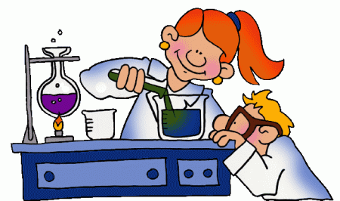
Metal + Oxygen → Metal Oxide
These reactions release heat by combustion. The metal oxides produced are alkalines (bases).
See the examples on page 35.
(Note too how they have balanced these equations).
Iron + Oxygen → Iron Oxide (Rust)
How do you stop iron from rusting? You make sure it does not come into contact with the Oxygen in the air – by using paint, a coating of another metal, oil, etc.

